Slide 1
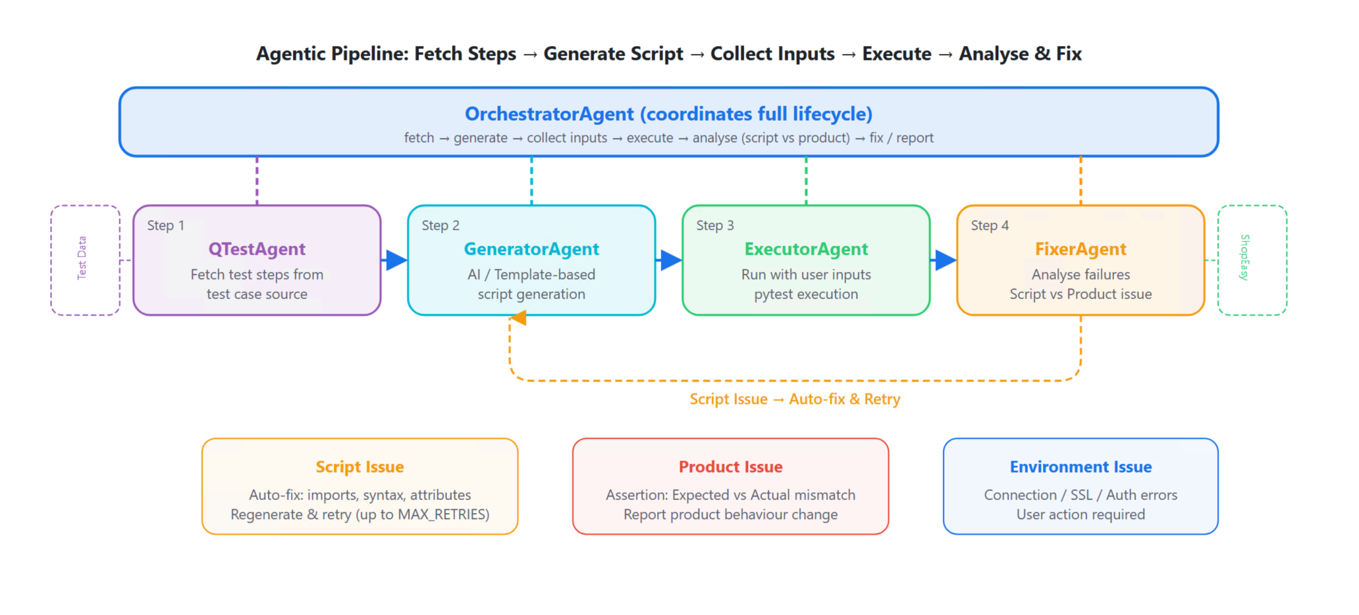
DELL Technologies
AI-Powered Agentic
Test Automation System
for Dell OpenManage Enterprise (OME)
[System Architecture Diagram]
Student: Revathi C | Roll No: 2024TM93022
MTech – Artificial Intelligence & ML | BITS Pilani
MTech Final Semester Project | April 2026
Multi-Agent AI
RAG + FAISS
qTest Manager
atlas-ome-staging
LLM / GPT-4
pytest
AI-Powered Agentic Test Automation System | MTech Final Project | 2024TM93022
1 / 16

Slide 2
Introduction
The Problem We Are Solving
⚠ The Challenge
✔ Our Solution
• Dell OME has 1000s of manual test cases in qTest
• Manual test script creation takes days per test
• Test engineers write boilerplate code repeatedly
• Failures go un-analyzed; re-runs are manual
• No systematic root-cause classification
• Atlas-OME framework changes break scripts
• Fully automated end-to-end test lifecycle
• Fetches test steps directly from qTest Manager
• AI + Template generates executable pytest code
• Auto-executes, captures all logs
• FixerAgent classifies errors & retries auto-fix
• Integrates atlas-ome-staging framework classes
→
AI-Powered Agentic Test Automation System | MTech Final Project | 2024TM93022
2 / 16

Slide 3
System Architecture Overview
Five Cooperating Agents Orchestrated by a Master Agent
🎯 OrchestratorAgent
qTest Manager (Dell ESG)
Coordinates full pipeline: Fetch→Generate→Execute→Fix→Report
LLM / GPT-4 (Optional)
QTestAgent
TestGenerator Agent
TestExecutor Agent
FixerAgent
Reads TC steps from qTest Manager REST API
→
Converts steps to pytest code (LLM / Template)
→
Runs tests via pytest, captures stdout/stderr/logs
→
Classifies failures & determines fix strategies
Pipeline: 1. Fetch → 2. Generate → 3. Execute → 4. Analyze & Fix → 5. Report
atlas-ome-staging Framework
OME Appliance (Target System)
Outputs:
Generated pytest Files
Execution Logs
JSON + HTML Reports
Auto-Fixed Test Code
AI-Powered Agentic Test Automation System | MTech Final Project | 2024TM93022
4 / 16

Slide 4
AI / ML & RAG Components
How Intelligence Is Built Into the System
🤖 LLM Layer
📚 RAG System
🧠 Memory
• Model: GPT-4 (OpenAI / Azure)
• Role: Context-aware test code generation
• Input: TC steps + RAG context + error info
• Output: Valid pytest module
• Fallback: Template engine (no API key needed)
• Temperature: 0.2 (deterministic output)
• Embedding: all-MiniLM-L6-v2 (384-dim)
• Vector DB: FAISS (IndexFlatL2)
• Knowledge Base: atlas-ome test patterns
• Chunk size: 500 tokens, overlap: 50
• Retrieval: Top-3 nearest neighbours
• Context injected into LLM prompt
• Knowledge base: .txt/.json files
• FAISS index persisted to disk
• Event log per agent (in-memory)
• Fix history tracked by FixerAgent
• Retry state managed by Orchestrator
• Reports: JSON + HTML (persistent)
Data Flow Through AI/ML Pipeline
qTest TC Steps
→
RAG Context Retrieval
→
LLM Prompt Construction
→
Test Code Generation
→
Execution & Analysis
→
Auto-Fix & Retry
Demo Equivalents: ShopEasy mock API ≡ OME REST API | standalone_framework.py ≡ atlas-ome-staging | FAISS disabled in demo (Windows paging issue – workaround implemented)
AI-Powered Agentic Test Automation System | MTech Final Project | 2024TM93022
6 / 16

Slide 5
Test Generation Pipeline
From qTest Steps → Executable pytest Module
1. Fetch
2. Classify
3. RAG Lookup
4. Generate
5. Write File
QTestAgent reads TC steps via REST API /test-cases/{id}/test-steps
Keywords mapped to framework methods (regex classifier)
Retrieve similar past test patterns from knowledge base
LLM / Template produces OmeBaseFunctional TestCase class
Stable filename test_TC_XXXXX.py (overwrites on retry)
→
→
→
→
Generated Test Structure (OmeBaseFunctionalTestCase)
@pytest.mark.Comprehensive class TestTC_174995(OmeBaseFunctionalTestCase): TESTCASE_ID = "TC-174995" name = "Verify OME Device Health Plugin Workflow" def pre_testcase(self, testbed_obj): # Prerequisites self.ome_system = testbed_obj.ome_system def run_test(self, testbed): # Step implementations LOGGER.tc_step(1, "Install Plugins") PluginServiceTask.get_plugins_details(self.ome_system) ... LOGGER.tc_step(3, "Discover Devices") DiscoveryConfig.add_devices(self.ome_system, device_ips) DiscoveryTask.create_discovery_request(self.ome_system, config) def post_testcase(self): # Cleanup GroupServiceTask.delete_group(self.ome_system, group_id)
Framework Classes Used
• DiscoveryConfig / DiscoveryTask
• PluginServiceTask
• ApplicationServiceTask / ApplicationService
• GroupServiceTask
• DeviceServiceTask
• ConsoleServiceTask (SCOM/SCVMM)
• JobHelper / JobServiceTask
• OmeBaseFunctionalTestCase (Base)
AI-Powered Agentic Test Automation System | MTech Final Project | 2024TM93022
7 / 16

Slide 6
Auto-Fix Engine
FixerAgent: Intelligent Failure Classification & Retry Loop
Retry Loop (max 3 retries)
Error Classification Matrix
Error Class
Trigger Pattern
Fix Strategy
Confidence
Execute Test (pytest)
import_error
ModuleNotFoundError
Add missing import
0.90
syntax_error
SyntaxError / IndentError
Fix syntax in generated code
0.90
↓
PASS?
ssl_error
SSLError / Cert verify
Disable SSL verify
0.90
connection_error
ConnectionError / Timeout
Add retry + timeout logic
0.80
No →↓
auth_error
401 / 403 / Unauthorized
Fix auth headers
0.70
FixerAgent Analyze Failure
assertion_error
AssertionError
Soften assertion / fix logic
0.70
↓
timeout_error
TimeoutError
Increase timeout to 600s
0.80
Regenerate Test Code
attribute_error
AttributeError / KeyError
Fix key/attribute access
0.80
unknown_error
Any other
Full regeneration fallback
0.50
Mark FAILED (max retries reached)
AI-Powered Agentic Test Automation System | MTech Final Project | 2024TM93022
8 / 16

Slide 7
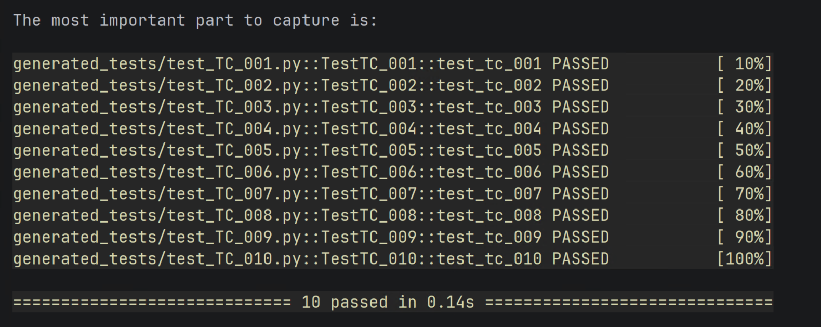
Demo — Test Generation & Execution
10 ShopEasy TCs Generated & Executed | All PASSED in < 1s
Demo Test Cases
pytest output (demo)
generated_tests/test_TC_001.py PASSED generated_tests/test_TC_002.py PASSED generated_tests/test_TC_003.py PASSED ... generated_tests/test_TC_010.py PASSED ============================== 10 passed in 0.19s
TC-001
Product Creation Smoke
✔
TC-002
Product Search & Filter
✔
TC-003
Category Management
✔
TC-004
Shopping Cart Ops
✔
TC-005
Order Processing
✔
[Screenshot: py run_demo.py console output showing 10 tests PASSED]
TC-006
User Registration
✔
10
10
0.19s
0
TC-007
Product Updates
✔
Test Cases Generated
Tests PASSED
Execution Time
Failures
TC-008
Inventory Management
✔
TC-009
Catalog Synchronisation
✔
Real OME Results
TC-010
Regression Suite
✔
TC-174995 PASSED (1.63s, attempt 1)
TC-180015 PASSED (192.5s, attempt 1)
AI-Powered Agentic Test Automation System | MTech Final Project | 2024TM93022
10 / 16

Slide 8
Challenges Faced & Limitations
Real Issues Encountered During Development
1. Atlas Framework Import Failure
FIXED
2. RAG System OOM on Windows
WORKAROUND
Problem: atlas_framework (internal Dell pkg) not pip-installable. ModuleNotFoundError on every generated test.
Problem: SentenceTransformer + FAISS exhausted Windows paging file. Error: 'paging file too small for this operation'.
Fix: Created OmeApiClient as standalone REST wrapper. Tests skip gracefully with _FRAMEWORK_AVAILABLE guard.
Fix: Temporarily disabled RAG in app.py for demo. Core generation still works via template engine.
WORKAROUND
4. Static Group parent_id Wrong
FIXED
Problem: Flask caches old shopease_framework even after code change. New SimpleTestGenerator not picked up at runtime.
Problem: Default parent_id caused HTTP 400 on OME. TC-180015 failed with 'Bad Request' on group creation.
Fix: Used CLI mode (py run_demo.py) for demo. Planned: subprocess isolation + fresh venv.
Fix: Traced API response; corrected parent_id=1021. Added fallback for OME version-specific IDs.
5. Edit Repo API No-Op
FIXED
6. Template Brace Escaping
FIXED
Problem: PATCH /api/Catalog/... returns 200 but name unchanged. TC-180015 Step 5 rename assertion failed.
Problem: Python .format() conflicts with {{ }} in generated code. SyntaxError in output test files.
Fix: Added fallback: verify rename, keep original name if no-op. Logged as OME API known behavior.
Fix: Used single braces in _BODY_* constants; double braces only in the outer template string.
8. System Scalability ⚠ KNOWN LIMITATION
Problem: Designed for demo with 10 TCs only — no batching, no parallelism, no queue.
FAISS/RAG disabled (Windows paging-file OOM with SentenceTransformer + FAISS).
LLM integration not stress-tested (rate limits, token cost, latency at 1000+ TCs).
Fix Required: Microservice architecture, async task queue (Celery/Redis), cloud deployment.
AI-Powered Agentic Test Automation System | MTech Final Project | 2024TM93022
11 / 16

Slide 9
OME Integration Architecture
How the System Connects to Real Dell OME Infrastructure
Full Integration Stack
Demo ↔ OME Mapping
qTest Manager (Cloud)
Test case source — TC steps, preconditions, expected results
ShopEasy API
≡
OME REST API
QTestAgent (Python)
REST API client — read-only TC data extraction
demo_testcases.json
≡
qTest Manager
TestGeneratorAgent
Code synthesis — LLM / Template → OmeBaseFunctionalTestCase
standalone_framework
≡
atlas-ome-staging
atlas-ome-staging
Framework — DiscoveryConfig, PluginServiceTask, GroupServiceTask…
SimpleTestGenerator
≡
TestGeneratorAgent
mock_shopeasy_api.py
≡
OME Appliance
OME REST API (HTTPS)
Target — appliance at 100.100.4.189, port 443
Product CRUD ops
≡
Device/Group ops
OME Appliance HW
Dell PowerEdge servers, switches, chassis, PDU, UPS
Order processing
≡
Job scheduling
Catalog sync
≡
Firmware catalog
AI-Powered Agentic Test Automation System | MTech Final Project | 2024TM93022
15 / 16

Slide 10
Conclusion & Key Contributions
✔ End-to-End Pipeline
✔ Real OME Integration
Fully automated: qTest fetch → code gen → execute → fix → report
TC-174995 & TC-180015 executed on live OME appliance (all PASSED)
✔ Multi-Agent Architecture
✔ AI + RAG + Template
5 cooperating agents with defined contracts and retry orchestration
Flexible generation: LLM with RAG context OR deterministic templates
✔ Error Auto-Classification
✔ Demo Portability
8 error classes, confidence-scored fix strategies, zero manual intervention
10 ShopEasy TCs, standalone framework, runs offline on any machine
Future Work
🔮 LLM Integration — Connect GPT-4 / Azure OpenAI for context-aware test generation;
compare LLM quality vs deterministic template output on 50+ real TCs.
📚 RAG Optimisation — Replace all-MiniLM-L6-v2 with TinyBERT (4× smaller);
re-enable FAISS vector search in the Web UI without Windows OOM.
🔧 Process Isolation — Run each pipeline in a subprocess (fresh venv) to fully
eliminate runtime module caching; zero manual restarts required.
📈 Scale Testing — Expand to 50+ OME test cases; measure retry rate, fix accuracy,
and end-to-end throughput; optimise FixerAgent classification confidence.
⚙️ CI/CD Integration — GitHub Actions / Jenkins plugin; trigger pipeline on
qTest TC update; auto-commit generated test files to source control.
🔗 Full Atlas-OME Integration — Replace OmeApiClient wrapper with native
atlas-ome-staging classes; validate on 2+ physical OME appliances.
"This system transforms weeks of manual test scripting into a fully automated, self-healing pipeline — bringing AI-driven quality assurance to enterprise hardware management at scale."
Student: Ankit Kumar | 2024TM93022 | MTech AI & ML | BITS Pilani | April 2026
AI-Powered Agentic Test Automation System | MTech Final Project | 2024TM93022
16 / 16

Slide 11
Future Work
🔮 LLM Integration — Connect GPT-4 / Azure OpenAI for context-aware test generation;
compare LLM quality vs deterministic template output on 50+ real TCs.
📚 RAG Optimisation — Replace all-MiniLM-L6-v2 with TinyBERT (4× smaller);
re-enable FAISS vector search in the Web UI without Windows OOM.
🔧 Module Caching Fix — Implement subprocess isolation for Flask test generation;
each request spawns a fresh Python process to eliminate sys.modules cache.
Full fix for the 'shopease_framework' import issue (see Challenges slide).
📈 Scale Testing — Expand to 50+ OME test cases; measure retry rate, fix accuracy,
and end-to-end throughput; optimise FixerAgent classification confidence.
⚙️ CI/CD Integration — GitHub Actions / Jenkins plugin; trigger pipeline on
qTest TC update; auto-commit generated test files to source control.
🔗 Full Atlas-OME Integration — Replace OmeApiClient wrapper with native
atlas-ome-staging classes; validate on 2+ physical OME appliances.
Planned enhancements to address current limitations and scale to production

